Slide 1
INSY 442 · DATA ANALYSIS & VISUALIZATION
Good vs. Bad Data
Visualizations in Power BI
Visualization design Comparisons and Rationale
Using Canadian Retail Sales Data

Slide 2
AGENDA
Topic inspiration & data sources
Q1 · Category rankings over time
Q2 · Drivers of the 2024–25 sales change
Q3 · Geographic concentration of sales
Q4 · Provincial performance over time
Q5 · Dependence on one retail category
Key takeaways

Slide 3




1. Topic Inspiration & Data Sources
Topic Inspiration
Dataset at a Glance
r/dataanalysis
“First dashboard, any suggestions?”
2022–26
10
Dataset Source
Monthly retail sales
Provinces
Statistics Canada
Table 20-10-0056-02
Monthly retail trade sales by industry
9
5
Data Preparation
Cleaned to 2022–2026
10 provinces · 9 major retail categories · monthly sales
Major retail categories
Business questions tested
3
Data
Q1
Q2
Q3
Q4
Q5
Takeaways

Slide 4

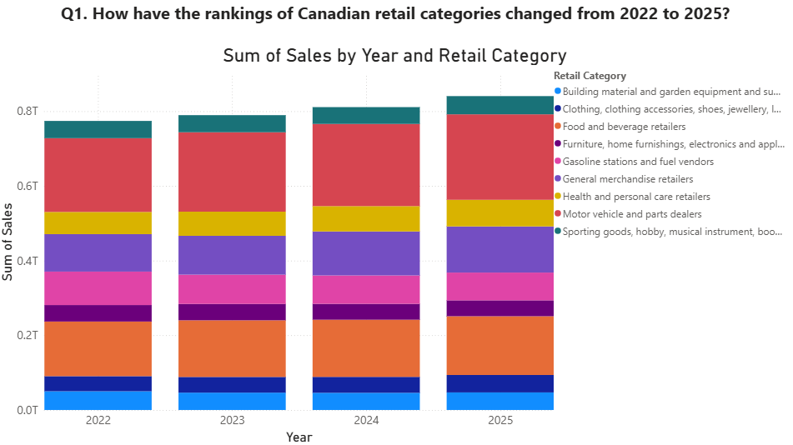

2.1 Stacked bars bury the ranking story
Question 1
Visualization — Stacked bar chart
How have the rankings of Canadian retail categories changed from 2022 to 2025?
Why this visualization doesn't work
Stacked bar chart
Category rankings are difficult to track across years.
Stacked segments lack a common baseline, making comparisons difficult.
Changes in total sales can distract from changes in relative ranking.
Categories moving up or down in rank are not immediately visible.
4
Data
Q1
Q2
Q3
Q4
Q5
Takeaways

Slide 5
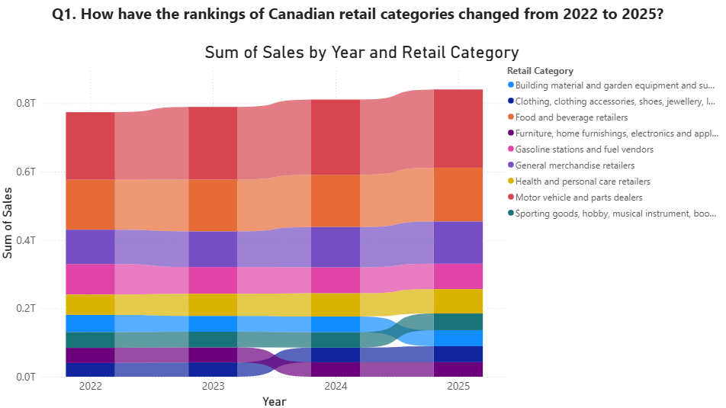

2.2 A ribbon chart makes rank shifts visible at a glance
Question 1
Visualization — Ribbon chart
How have the rankings of Canadian retail categories changed from 2022 to 2025?
Why this visualization works
Ribbon chart
Vertical position makes category rankings easier to identify.
Crossing ribbons clearly highlight changes in rank.
Categories can be easily tracked across multiple years.
Changes in relative position are immediately visible.
5
Data
Q1
Q2
Q3
Q4
Q5
Takeaways

Slide 6
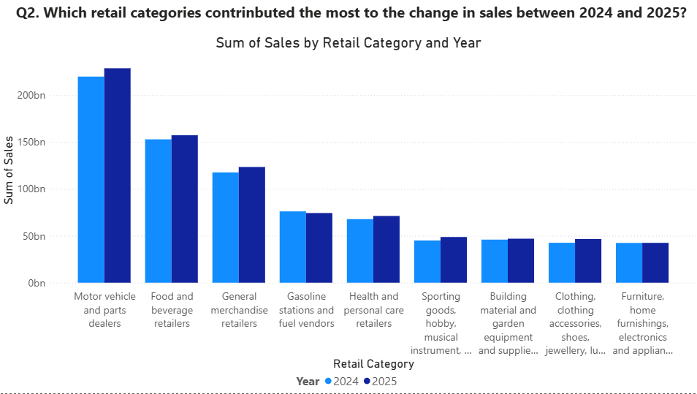
3.1 Clustered columns force viewers to calculate the change
Question 2
Visualization — Clustered column chart
Which retail categories contributed the most to the change in sales between 2024 and 2025?
Why this visualization doesn't work
Clustered column chart
Focus on total sales levels rather than the change in sales.
Requires viewers to mentally calculate the difference between 2024 and 2025.
Similar bar heights make smaller changes difficult to identify.
Positive and negative changes are not immediately distinguishable.
Difficult to determine which categories contributed most to the overall change.
6
Data
Q1
Q2
Q3
Q4
Q5
Takeaways

Slide 7
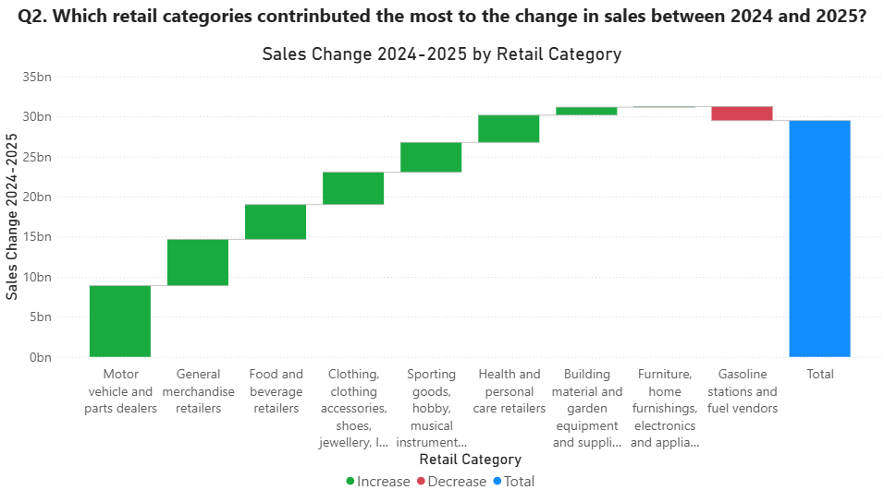
3.2 A waterfall shows each category's contribution to the change
Question 2
Visualization — Waterfall chart
Which retail categories contributed the most to the change in sales between 2024 and 2025?
Why this visualization works
Waterfall chart
Direct visualization of the change in sales from 2024 to 2025.
Clear identification of positive and negative contributions.
Categories contributing most to the overall change are easy to identify.
Cumulative effect of each category shown clearly.
Final total provides context for the overall change in retail sales.
7
Data
Q1
Q2
Q3
Q4
Q5
Takeaways

Slide 8
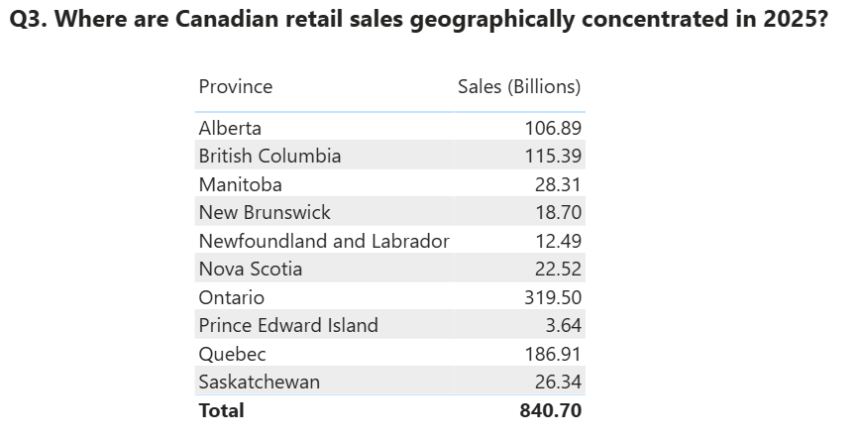
4.1 A table hides where sales are concentrated
Question 3
Visualization — Table
Where are Canadian retail sales geographically concentrated in 2025?
Why this visualization doesn't work
Table
Geographic patterns are not immediately visible.
Requires manually comparing sales values across provinces.
Difficult to see where high- and low-sales provinces are located.
Geographic concentration cannot be identified at a glance.
Better for retrieving exact values than understanding spatial patterns.
8
Data
Q1
Q2
Q3
Q4
Q5
Takeaways

Slide 9
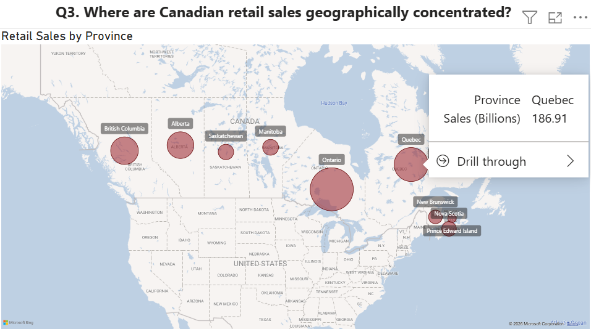
4.2 A bubble map reveals geographic concentration instantly
Question 3
Visualization — Map visual
Where are Canadian retail sales geographically concentrated in 2025?
Why this visualization works
Map visual
Province locations provide immediate geographic context.
Bubble size makes differences in sales magnitude visually apparent.
High-sales regions are easier to identify at a glance.
Geographic concentration and regional patterns are easier to recognize.
Tooltips provide exact sales values when needed.
9
Data
Q1
Q2
Q3
Q4
Q5
Takeaways

Slide 10
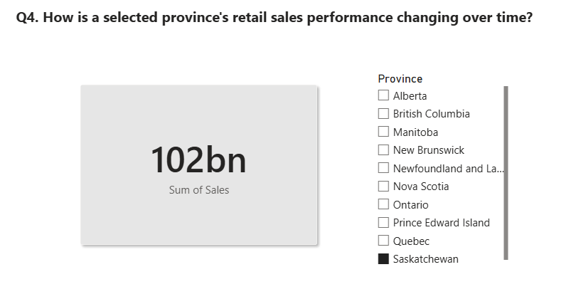
5.1 A single card gives no sense of direction or change
Question 4
Visualization — Card
How is a selected province's retail sales performance changing over time?
Why this visualization doesn't work
Card
Shows only the selected province’s total sales.
No comparison with previous-year performance.
Difficult to determine whether performance is improving or declining.
Large sales value provides little context on its own.
Does not directly answer the question about change over time.
10
Data
Q1
Q2
Q3
Q4
Q5
Takeaways

Slide 11
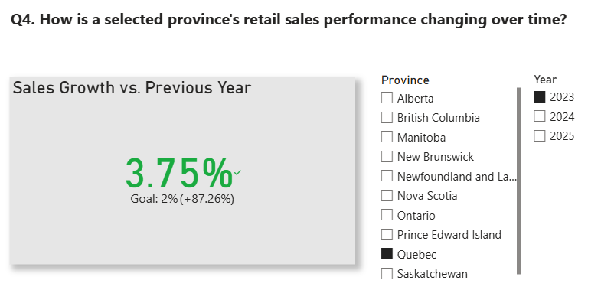
5.2 A KPI with a benchmark shows direction and magnitude
Question 4
Visualization — KPI with slicers
How is a selected province's retail sales performance changing over time?
Why this visualization works
KPI with slicers
Direct comparison with previous-year sales performance.
Percentage growth clearly shows the direction and magnitude of change.
Color provides an immediate visual signal of performance.
Benchmark provides context for interpreting the current result.
Province and year slicers allow flexible performance comparisons.
11
Data
Q1
Q2
Q3
Q4
Q5
Takeaways

Slide 12
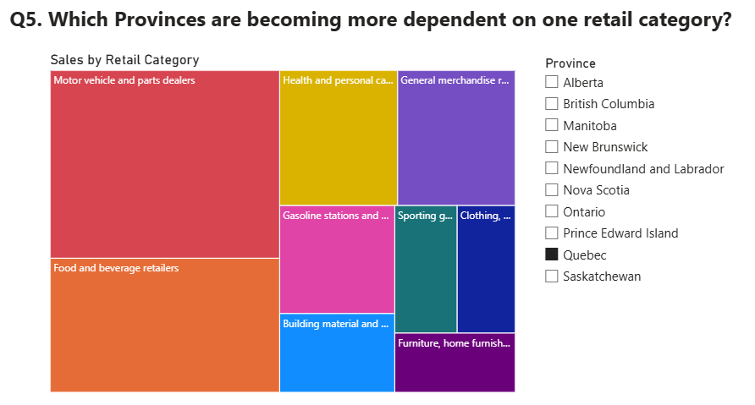
6.1 A treemap shows one snapshot, not a trend in dependence
Question 5
Visualization — Treemap
Which provinces are becoming more dependent on one retail category?
Why this visualization doesn't work
Treemap
Shows category composition for only one point in time.
No year-to-year comparison.
Difficult to determine whether dependence on a category is increasing or decreasing.
Rectangle areas are harder to compare precisely.
Does not directly answer the question about becoming more dependent over time.
12
Data
Q1
Q2
Q3
Q4
Q5
Takeaways

Slide 13
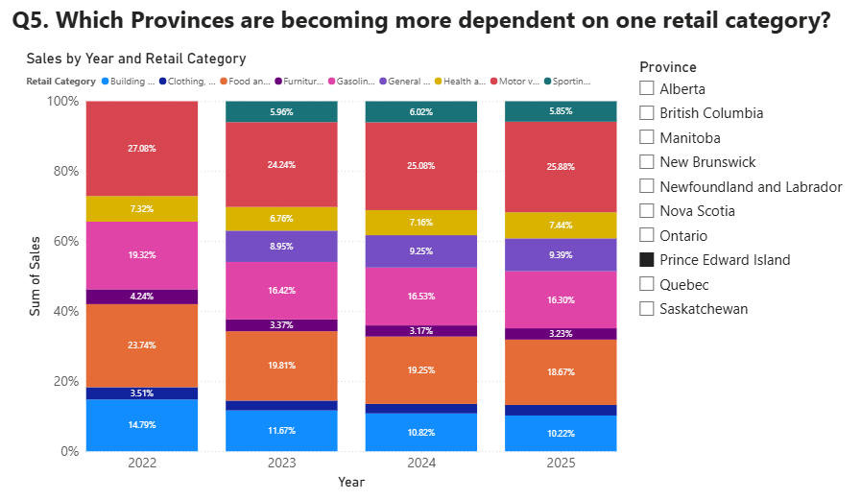
6.2 100% stacked columns expose shifting category shares
Question 5
Visualization — 100% stacked column chart
Which provinces are becoming more dependent on one retail category?
Why this visualization works
100% stacked column chart
Shows each category as a percentage of total provincial sales.
Easy comparison of category shares across years.
Increasing or decreasing dependence clearly visible over time.
100% normalization removes changes caused by overall sales growth.
Makes shifts in the province’s retail sales composition easier to identify.
13
Data
Q1
Q2
Q3
Q4
Q5
Takeaways

Slide 14
7. Key Takeaways: match the chart to the question
# | Question focus | ✕ Weak choice | ✓ Better choice | Design principle
Q1 | Category ranking changes, 2022–2025 | Stacked bar chart | Ribbon chart | Use position to encode rank
Q2 | Contributors to the 2024→2025 sales change | Clustered column chart | Waterfall chart | Chart the change itself, not the levels
Q3 | Geographic concentration of 2025 sales | Table | Map visual | Put spatial questions on a map
Q4 | Provincial performance over time | Card | KPI with slicers | Pair a value with a benchmark
Q5 | Growing dependence on one category | Treemap | 100% stacked column chart | Normalize to 100% to compare shares
14
Data
Q1
Q2
Q3
Q4
Q5
Takeaways

